Slide 1

Deep Reinforcement Learning in Cloud Elasticity through Offline Learning and Return Based Scaling
Hardik Khanna 16010122085 Ridham Jain 16010122070 Vivan Jain 16010122071 Aditya Kakar 16010122078
Batch: A3 Faculty Name: Prof. Zaheed Shaikh

Slide 2
🔍 Overview of the Paper
This research tackles cloud elasticity—the ability to scale cloud resources in real-time—with Deep Reinforcement Learning (DRL), while reducing the drawbacks of traditional online RL (like excessive interactions and performance overhead). It introduces a novel hybrid agent system named RBS-CQL, which:
Uses Double Deep Q-Network (DDQN) for online learning.
Uses Conservative Q-Learning (CQL) for offline reinforcement learning.
Introduces Return-Based Scaling (RBS) to optimize learning.

Slide 3
Introduction
Cloud-native, container-based apps are increasingly adopted due to ease of deployment and scaling.
Kubernetes (K8s) is a popular orchestration tool but its built-in autoscaling mechanisms (like HPA) rely on simple resource thresholds.
These threshold-based approaches are too simplistic.
DRL provides intelligent autoscaling but requires many training steps and can disrupt services during learning.
Challenges:
High dimensional state space – lots of continuous (non-discrete) parameters.
Long action latency – feedback from environment takes minutes.

Slide 4
Problem Statement
•Threshold-based methods are inflexible and reactive - They rely on static rules and cannot adapt to changing or unpredictable workloads.
•High cost and complexity of online training in live environments - Training DRL agents in real-time consumes resources and risks service disruption.
•Need for cost-efficient, learning-driven auto-scaling mechanisms - Intelligent systems must scale resources efficiently by learning from past behavior without expensive live training.

Slide 5
Objective of the Research
Here's a clear one-line explanation for each of those objective points:
Develop an intelligent DRL-based auto-scaler for cloud elasticity: Create a smart agent that learns how to scale cloud resources dynamically based on real-time and historical data.
Use offline data to reduce training overhead: Train the agent using pre-collected system logs to avoid the high cost and risk of live training.
Integrate Return-Based Scaling (RBS) and Conservative Q-Learning (CQL): Combine two advanced DRL techniques to improve long-term decision-making and safe offline learning.
Deploy and test on a Kubernetes + Cassandra environment: Validate the system in a real-world cloud setup managing a scalable NoSQL database under varying workloads.

Slide 6
Proposed System – RBS-CQL
Here are concise one-line explanations for each point:
RBS-CQL = Return-Based Scaling + Conservative Q-Learning: A hybrid approach that optimizes long-term rewards while ensuring safe offline learning.
Learns from historical data to avoid live environment risks: Uses past system logs to train the model without affecting current cloud performance.
Combines offline (CQL) and online (DDQN) training: Starts with offline learning and fine-tunes with minimal live interactions for faster, safer convergence.
Balances exploration and exploitation in scaling decisions: Makes smart decisions by trying new actions cautiously while relying on proven strategies.

Slide 7
Architecture Overview
Here are one-line explanations for each of the architecture components:
Components: Kubernetes, Cassandra, Prometheus, YCSB, DRL Agent: The system integrates key cloud tools for orchestration, monitoring, benchmarking, and intelligent decision-making.
Prometheus collects metrics (CPU, memory, latency): Acts as the monitoring layer, gathering real-time performance data from the system.
DRL agent processes metrics and triggers scaling in K8s: The agent analyzes incoming data and decides when to scale resources up or down.
YCSB simulates workload on Cassandra: Generates read/write operations to test system performance under realistic cloud traffic.

Slide 8
Deep Reinforcement Learning Agent
Here are one-line explanations for each point related to the DRL agent:
State: CPU, memory, latency, throughput: The agent observes these key system metrics to understand the environment’s current condition.
Actions: Scale up/down nodes/pods: It can adjust the number of resources dynamically to handle varying workloads.
Reward: Balance between performance and cost: The agent is trained to maximize efficiency while minimizing resource usage and expense.
CQL (offline) pre-training + DDQN (online) fine-tuning: Training starts with safe offline learning and is later refined with limited live interactions.

Slide 9
Conservative Q-Learning (CQL)
An offline RL method that trains from static datasets.
Adds a penalty to overestimated Q-values for actions not seen in the dataset.
Objective:
Uses KL-divergence as a regularizer.
Helps derive robust policies without online exploration.

Slide 10
Return-Based Scaling (RBS)
Here are one-line explanations for each point about Return-Based Scaling (RBS):
Traditional Q-learning considers immediate rewards: It focuses only on short-term outcomes of actions.
RBS evaluates future cumulative rewards (returns): It trains the agent to consider long-term effects of scaling decisions.
Improves early-stage learning and scaling stability: Leads to faster, smarter learning and more consistent scaling behavior.

Slide 11
Experimental Setup
Here are one-line explanations for each point about the experimental setup:
K8s Cluster with Cassandra nodes managed by DRL agent: A Kubernetes environment runs Cassandra, with the DRL agent making auto-scaling decisions.
Prometheus for monitoring; Grafana for visualization: Prometheus gathers performance data, while Grafana provides dashboards to track system behavior.
YCSB generates synthetic workloads: Simulates realistic traffic to test how the system responds under different load conditions.
Metrics: latency, resource usage, cost, reaction time: Key performance indicators used to evaluate the effectiveness of the scaling strategy.

Slide 12
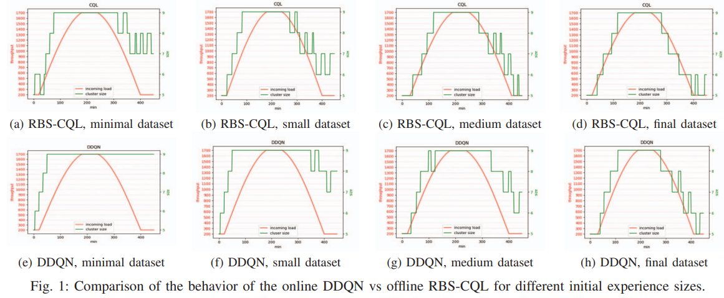
Comparison of the behavior of RBS-CQL vs DDQN

Slide 13
📊 5. Results & Performance
Here are one-line explanations for each result point:
10%+ improvement in early learning stage vs. online-only DRL: The hybrid RBS-CQL model learns faster in the initial phases compared to fully online methods.
Faster convergence with fewer training iterations: The agent reaches optimal scaling behavior more quickly, saving time and resources.
Stable performance under workload fluctuations: Maintains consistent application performance even with changing traffic patterns.
Cost-efficient resource utilization and scaling: Uses just enough resources to meet demand, minimizing unnecessary cloud costs.

Slide 14
📊 5. Results & Performance
Dataset Size | DDQN Reward | RBS-CQL Reward | Improvement
300 exp | 581.43 | 642.73 | +10.5%
800 exp | 601.74 | 670.05 | +11.3%
1800 exp | 659.71 | 698.36 | +6.1%
3300 exp | 690.42 | 714.62 | +3.5%

Slide 15
Conclusion & Future Work
Here are one-line explanations for each conclusion/future work point:
RBS-CQL enables efficient and adaptive auto-scaling: The system intelligently adjusts resources based on learned behavior, improving performance and efficiency.
Offline learning reduces live system impact: Training with historical data avoids disrupting live services and lowers operational risk.
Future: multi-agent learning, predictive scaling, multi-cloud support: Upcoming improvements may include collaboration between agents, forecasting workloads, and expanding across cloud providers.

Slide 16
Q&A / References
•IEEE CLOUD 2023 Paper: DRL in Cloud Elasticity via Offline Learning.
•Yahoo! Cloud Serving Benchmark (YCSB).
•Conservative Q-Learning (NeurIPS 2020).
•Prometheus & Kubernetes documentation.
•Any Questions?

Slide 17
THANK YOU

